Slide 1
Heart Disease Prediction Project.
By George Opondi.

Slide 2
INTRODUCTION
Heart disease is a type of disease that affects the heart or blood vessels. The risk of certain heart diseases may be increased by smoking, high blood pressure, high cholesterol, unhealthy diet, lack of exercise, and obesity. Heart disease describes a range of conditions that affect the heart. These diseases include:
a)Blood vessel disease, such as coronary artery disease
b)Irregular heartbeats (arrhythmias)
c)Heart problems you're born with (congenital heart defects)
d)Disease of the heart muscle
e)Heart valve disease

Slide 3
Details on the data set
This is a data set used to predict heart disease. Patients were classified as having or not having heart disease based on cardiac catheterization, the gold standard. If they had more than 50% narrowing of a coronary artery they were labeled as having heart disease.
In this cohort, there are 270 patients and there are 13 independent predictive variables or column attributes.

Slide 4
Sources
a) This data set came from the University of California Irvine data repository and is used to predict heart disease.
b) https://data.world/informatics-edu/heart-disease-prediction/workspace/file?filename=+Heart_Disease_Prediction.csv

Slide 5
Description of columns

Slide 6
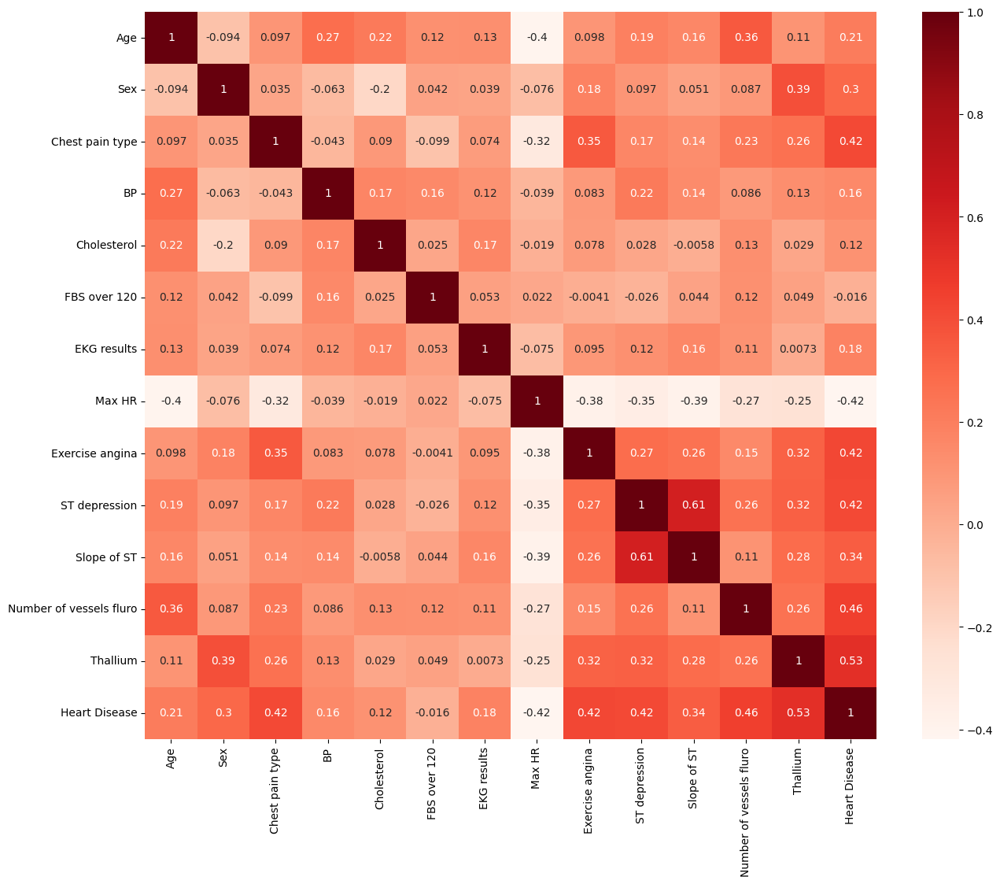
Correlation of variables

Slide 7
Correlation with output variable
Age 0.212322
Sex 0.297721
Chest pain type 0.417436
BP 0.155383
Cholesterol 0.118021
FBS over 120 0.016319
EKG results 0.182091
Max HR 0.418514
Exercise angina 0.419303
ST depression 0.417967
Slope of ST 0.337616
Number of vessels fluro 0.455336
Thallium 0.525020
Heart Disease 1.000000

